Slide 1

CryptoPursuerBot
Developer: Boiko Volodymyr

Slide 2
The purpose of the project
Cryptocurrency market – is an extremely volatile market, and to be successful in this market you need to get up-to-date information in real time and in a convenient way.
To achieve this goal, I decided to create a Telegram Bot, which will every minute process data from relevant Internet resources and notify the user of changes in the price of cryptocurrencies of interest to the user.

Slide 3
Technologe stack and resources
Internet resource that provides the necessary data on the quotation of cryptocurrency prices – CoinMarketCap.
Technology stack:
JavaScript
Node.js
API (Telegram, CoinMarketCap)

Slide 4
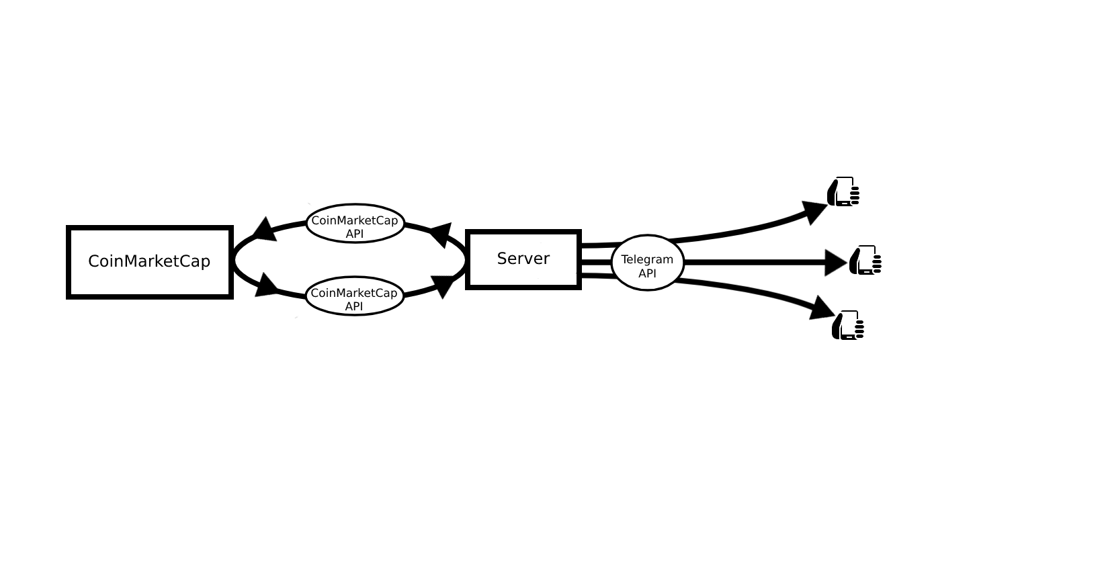
The principle of operation:
After launch, the server sends GET request to CoinMarketCap every minute using API. Having received up-to-date data on the percentage change in the price of all cryptocurrencies, the server for each user starts function which checks the received data with the data entered by the user and if the price of the corresponding cryptocurrency has risen to the level set by the user, then the server sends a message to the user using the Telegram API.

Slide 5
Options
Ability to select cryptocurrencies to track price changes.
Ability to set the value of the percentage change in the price at which the notification will be sent.
Ability to enable and disable tracking.

